Slide 1

Analysis of Fatal Crash Data - Australia
1989-2020
1
Interesting Questions
2
Information about the Data
3
Data Exploration and Clean Up Process
4
The Analysis Process
5
Conclusions
6
Implications

Slide 2
Questions?
How has the rate of road fatalities trended over time?
Are there any factors that increase the risk of crash fatalities?
Areas to consider:
^{time}
^{geographic}
^{demographic}
^{road usage}

Slide 3

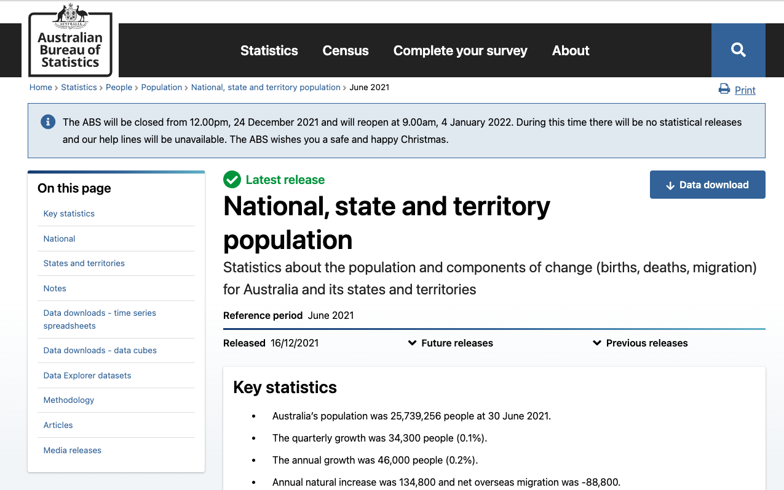
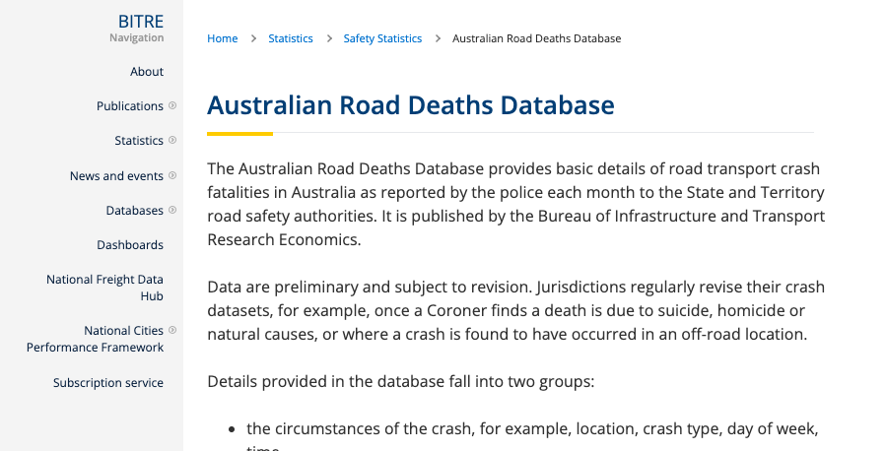

The Data
Australian Road Deaths
State Population Date
Bureau of Infrastructure, Transport, Regional Development and Communication
Australian Bureau of Statistics

Slide 4
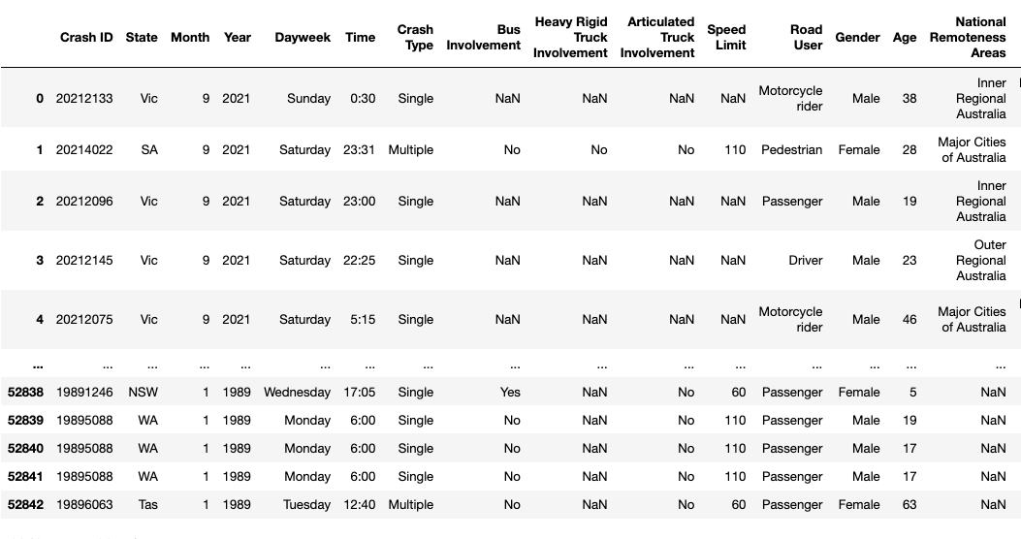
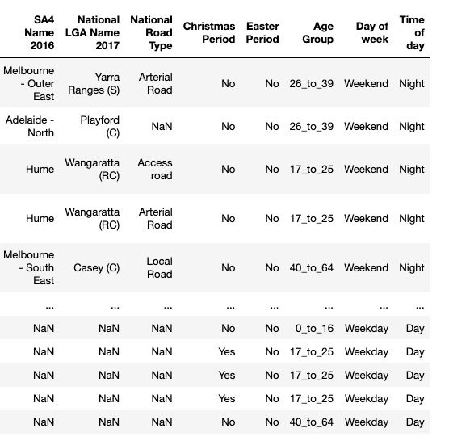
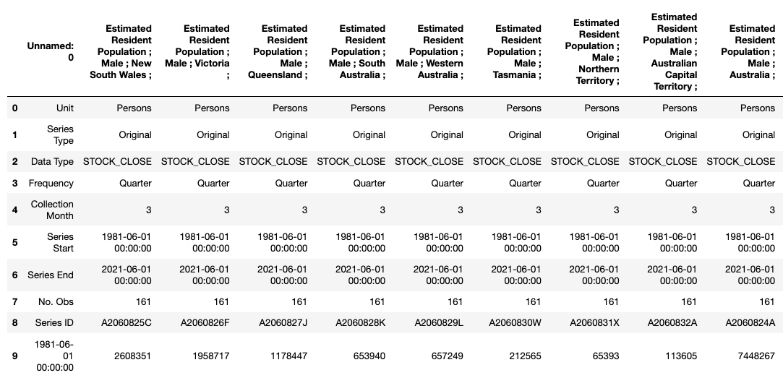
The Data continued…
Crash Data
Shape (52843,23)
Population
Notes:
The crash dataset was based on incident. The population dataset was based on 3-month periods with extraneous data in the top rows. It was segmented into columns by state and sex. A lot of cleaning had to occur to join the two.

Slide 5
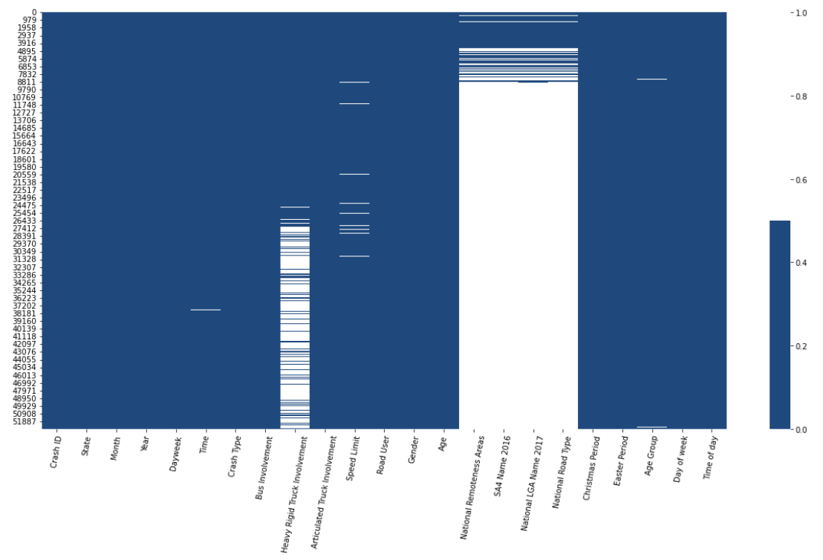
Data Exploration
Columns | % Missing
Crash ID | 0
State | 0
Month | 0
Year | 0
Dayweek | 0
Time | 0
Crash Type | 0
Bus Involvement | 0
Heavy Rigid Truck Involvement | 39
Articulated Truck Involvement | 0
Speed Limit | 1
Road User | 0
Gender | 0
Age | 0
National Remoteness Areas | 87
SA4 Name 2016 | 87
National LGA Name 2017 | 87
National Road Type | 87
Christmas Period | 0
Easter Period | 0
Age Group | 0
Day of Week | 0
Time of Week | 0
Notes:
We plotted the empty to understand what was missing. We found that certain columns were added over time. Knowing this, we could reduce the timeframe based on the periods for which the data was collected – if we wanted to glean information from those new fields.

Slide 6

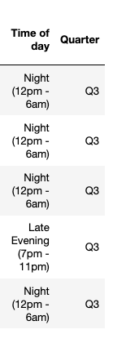
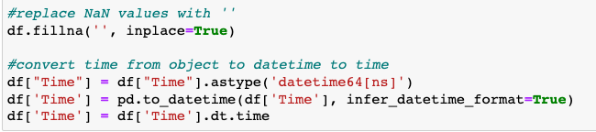
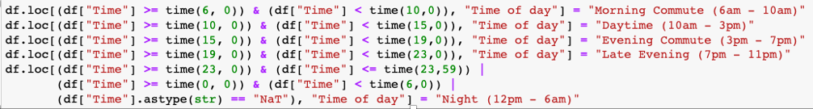
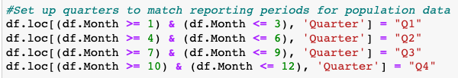
Cleaning (Crash Dataset)
Formatting Time
Adding Time of day
Adding Quarter
Notes:
Crash dataset was fairly clean and useable. We just needed to remove NaN values and convert time to format that could be compared.
The quarters were added so the population dataset could be merged based on state/year/quarter because that’s how the population data was collected.

Slide 7
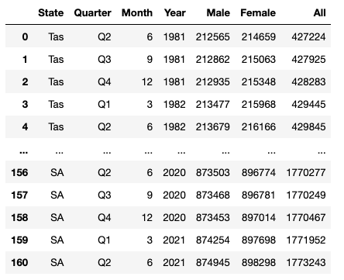
Cleaning (Population Dataset)
1
Rename Column Headers
2
Set columns to numeric
4
Retrieve Month and Year from Date
5
Create a Quarters Column
6
Create new DataFrame for each state with new columns
7
Combine into one DataFrame

Slide 8
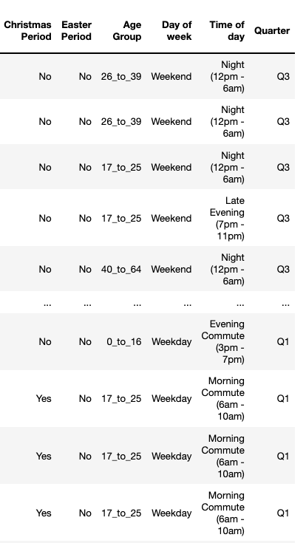
Merging Datasets
State - Year - Quarter

Slide 9
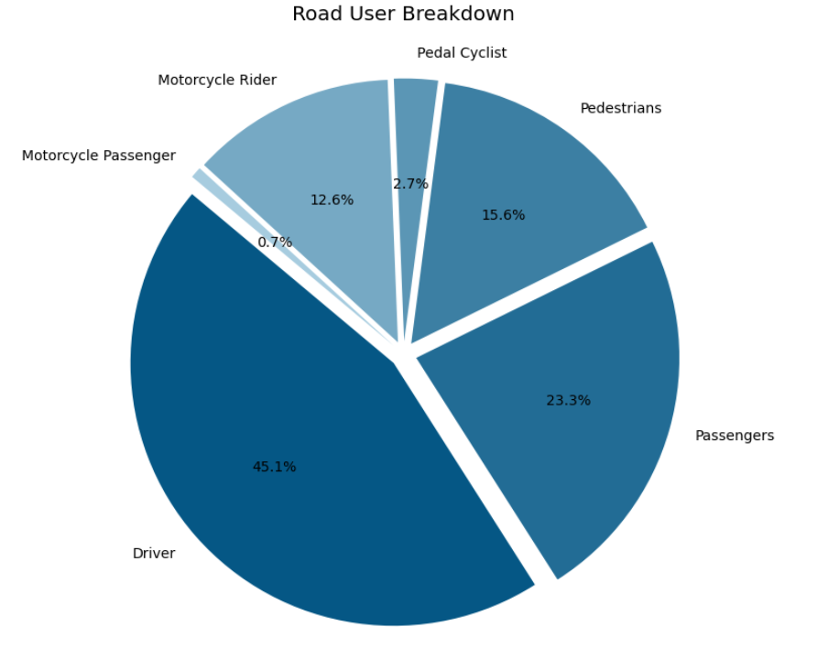
Summary of Data
Number of Accidents | 47,322
Total Fatalities | 52,566
% Female | 28
% Male | 72
Average Age | 40
Average Speed Limit | 82

Slide 10
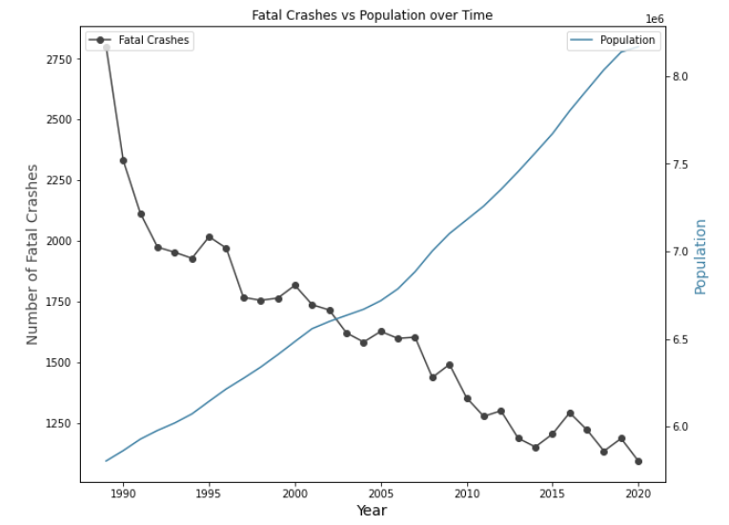
Time vs Fatalities Correlation - Australia
How has the fatality rate trended over time?
Conclusion:
Fatality rate and
time are negatively
correlated
-0.92

Slide 11
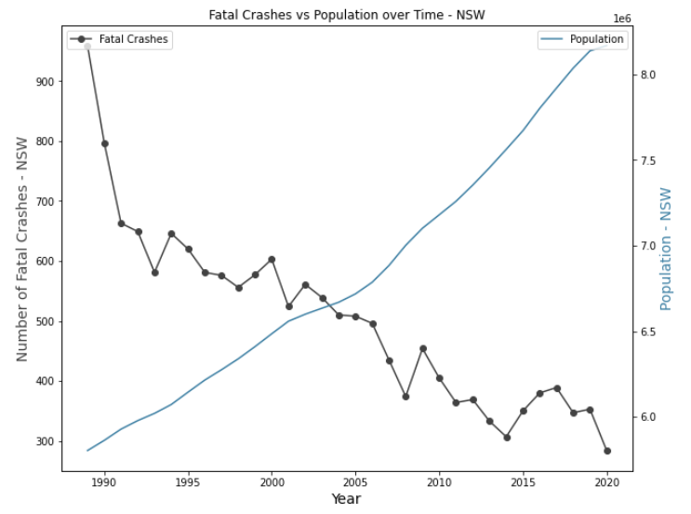
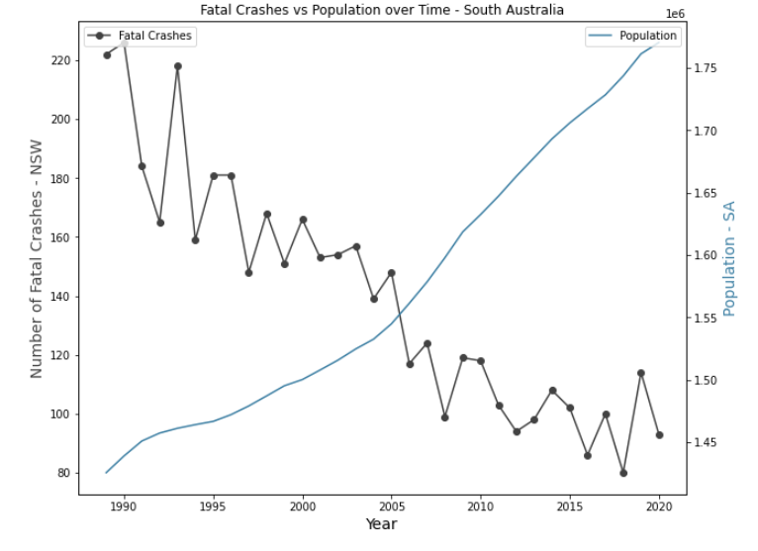
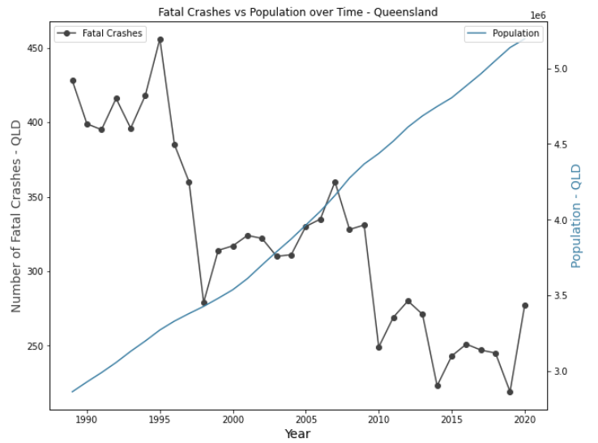
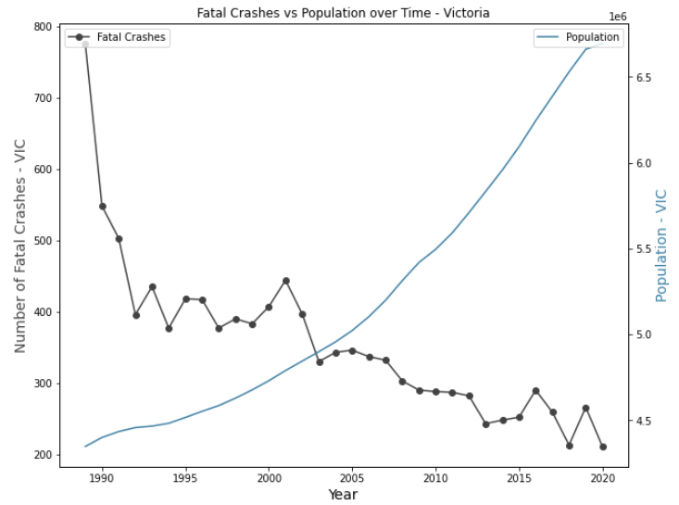
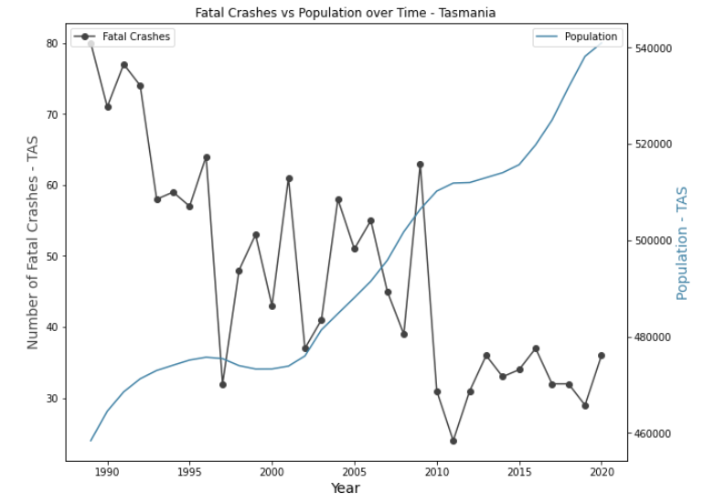
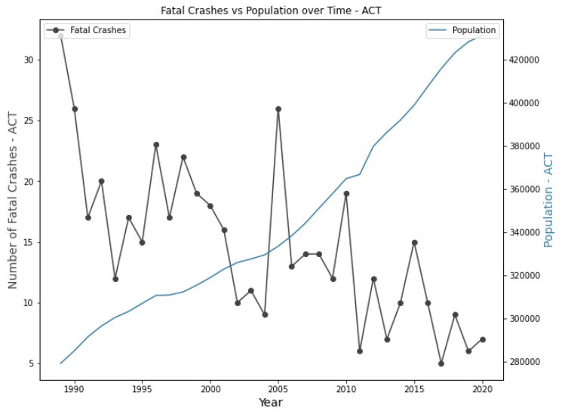
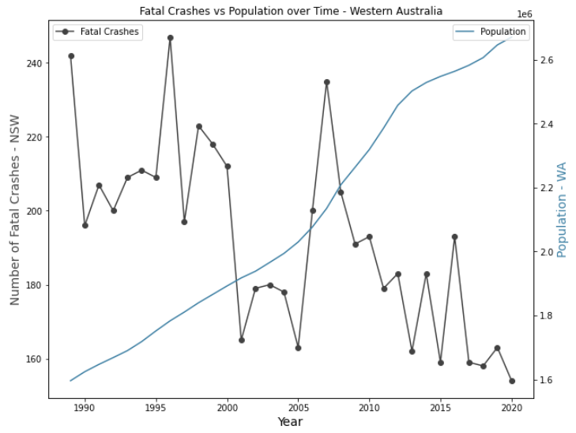
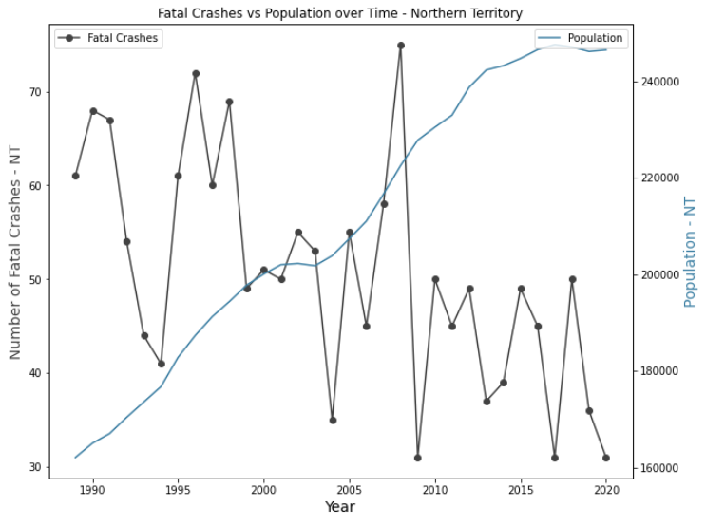
Time vs Fatalities Correlation – by State
How has the fatality rate trended over time per state?
NSW
SA
QLD
VIC
-0.89
-0.89
-0.86
-0.77
TAS
ACT
WA
NT
-0.74
-0.71
-0.67
-0.57
Conclusion: Per state, fatality rate and time are negatively correlated but vary in degree

Slide 12
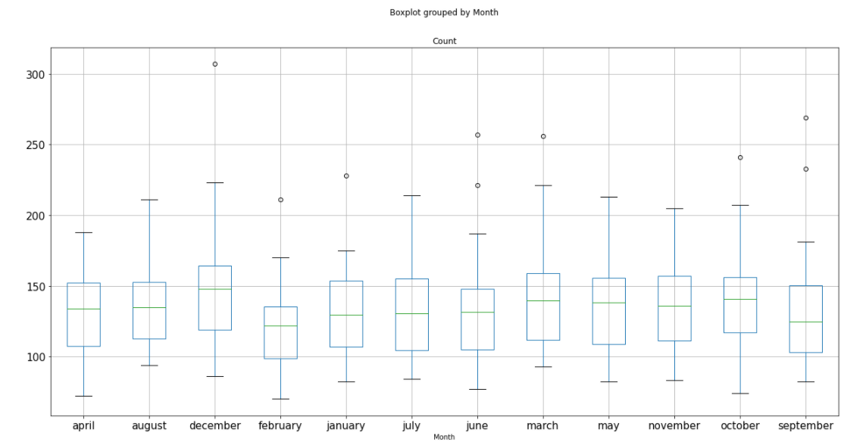
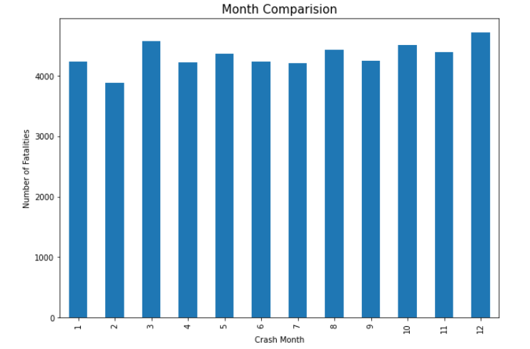
Time: Month
Is there correlation between month and number of fatalities?
P-value = 0.29948876
Conclusion: Not statistically significant
Notes:
The P-Value on the array showed no significant statistical difference between the months. However,

Slide 13
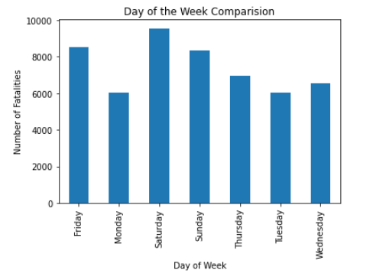
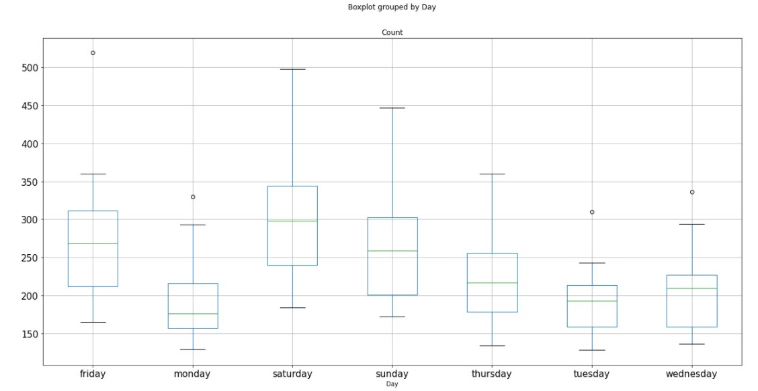
Time: Day of the Week
Is there a correlation between day of the week and number of fatalities?
P-value = 1.025e-15
Conclusion: Statistically Significant

Slide 14
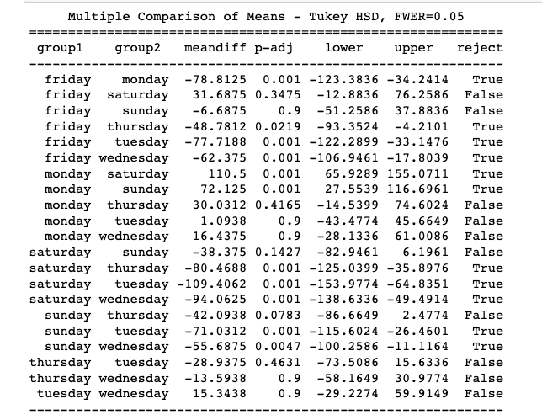
Time: Week Comparison continued
Statistically Significant >
Saturday
Friday
Sunday

Slide 15
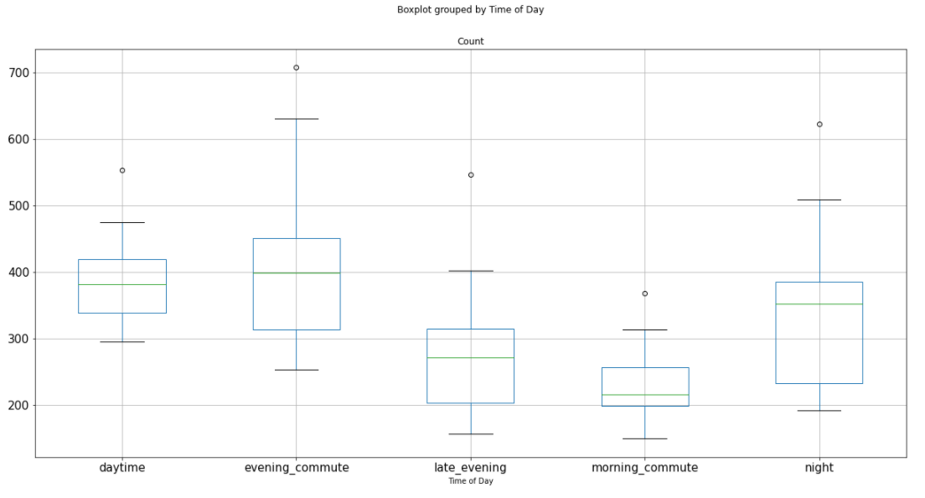
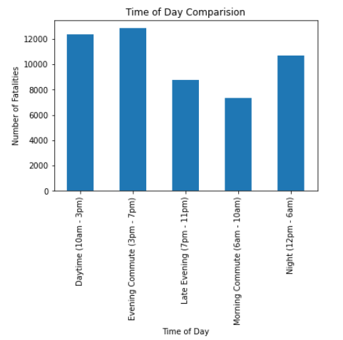
Time: Day of the Week
Is there correlation between day of the week and number of fatalities?
P-value = 1.0527e-15
Conclusion: Statistically Significant

Slide 16
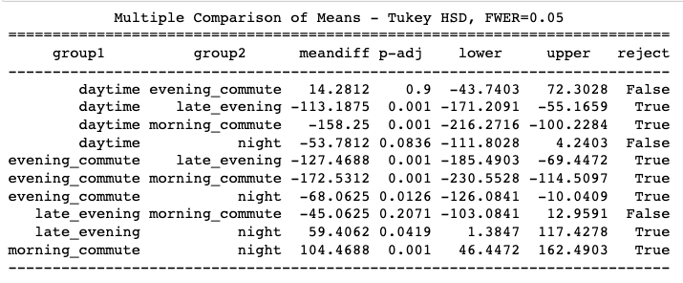
Time: Time of Day Comparison continued
Statistically Significant >
Evening Commute
Daytime
Night

Slide 17
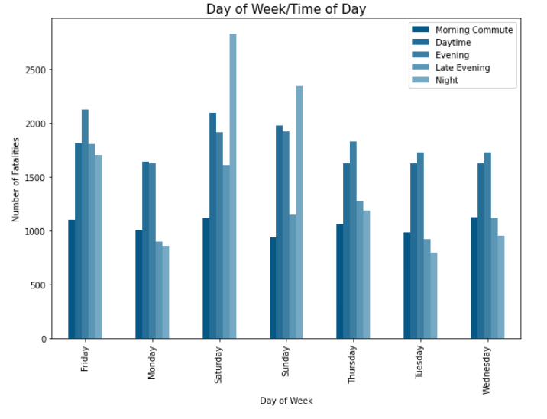
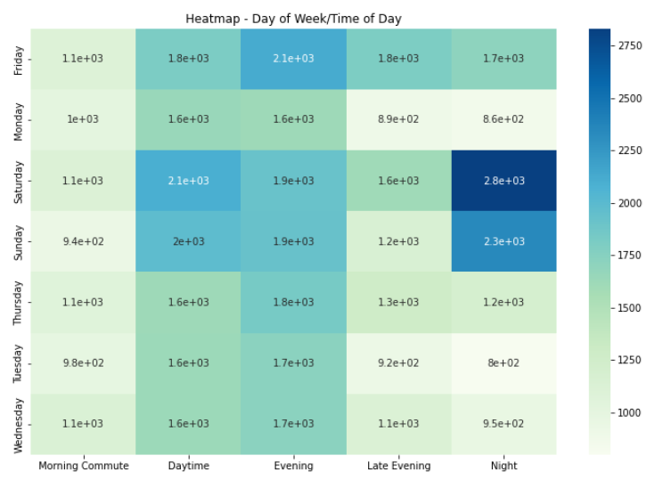
Time: Day of the Week and Time of Day
Conclusion: Crash time of day varies based on day of week

Slide 18





Implication: Time Matters
Intervention, whether legislation, safety parameters or other measures seem to have significantly impacted the rate of car crash fatalities since 1989.
There has not been a statistically significant increase in fatal crashes around major holidays (Christmas and Easter), or any particular month.
Time of day matters as well. Overall, evenings have a statistically significant increase in number of fatal crashes.
There is a statistically significant increase in fatal crashes on Saturday, Friday and Sunday, respectively.
Fatal crashes occurring at night are more common on Saturday and Sunday.

Slide 19
Demographic View
Has gender influenced the rate of road fatalities over time been?
Has age influenced the rate of road fatalities over time been?

Slide 20
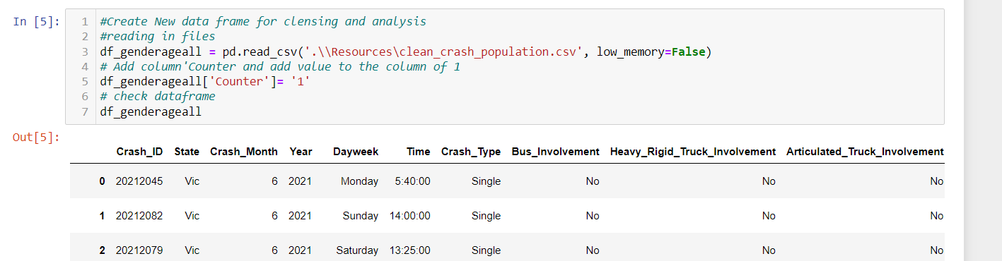
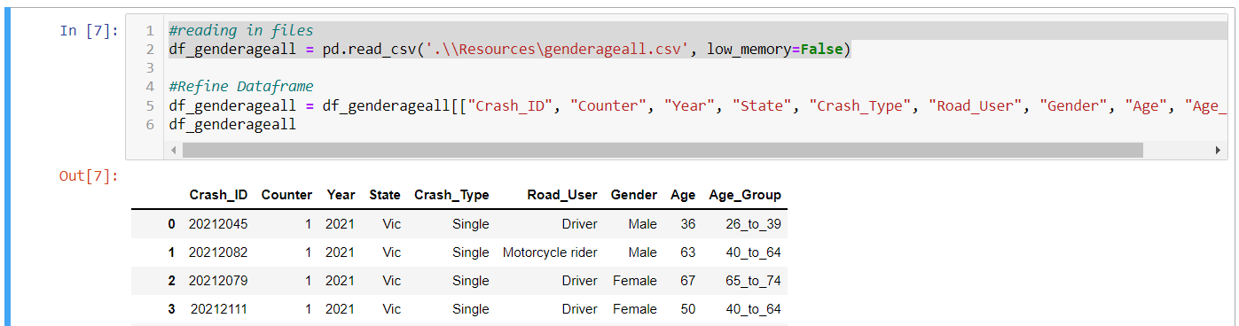
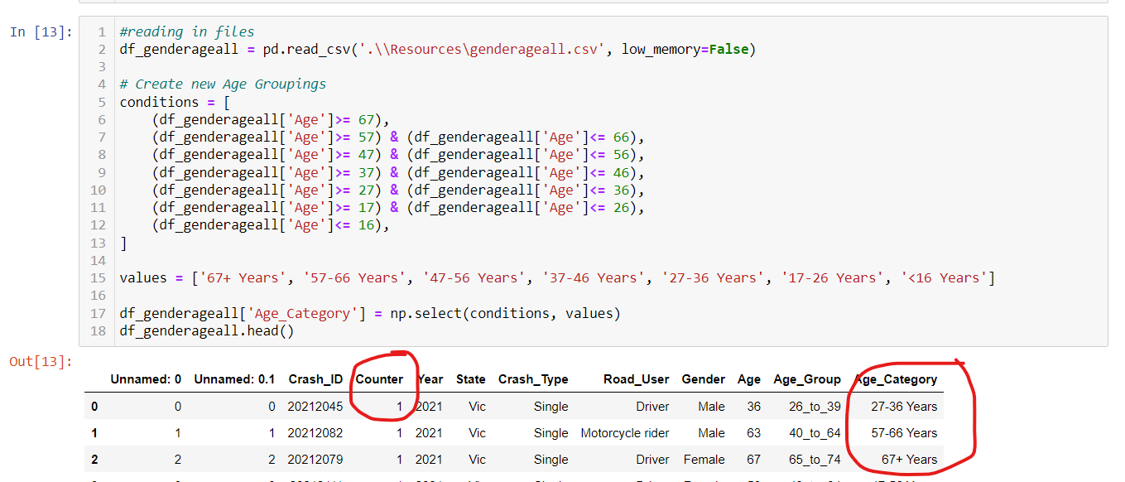
Demographic View – Approach to the data
The cleansed ‘fatalities’ data set produced was the starting data set for observations to be undertaken.
As the specific questions for consideration related to age and gender the original data set had non-relevant information removed to make the set easier to work with.
A ‘Counter’ column was added and then the Age_Category grouping (by 10 year increments) was added

Slide 21
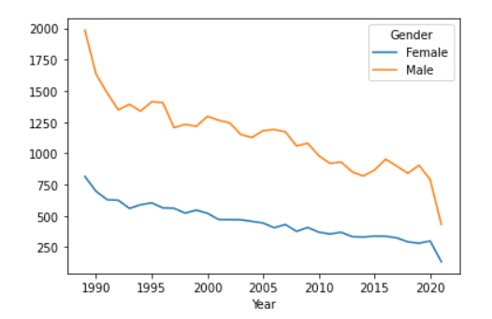
Demographic View: Gender
Overall Fatality Trending – By Gender Overtime:
Suggests while Males represent a greater portion of the fatalities by # but fatalities have dropped at a higher rate than Females.
Question: Have Males reduced the incidence of road fatality at a greater rate than women over the past 20 year?

Slide 22
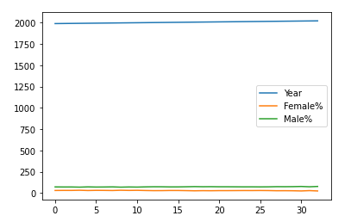
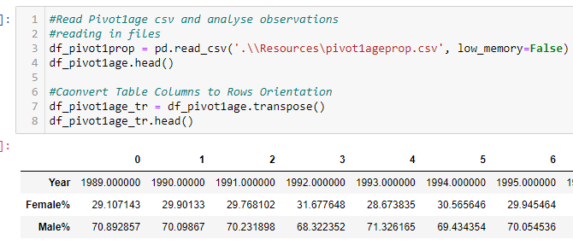
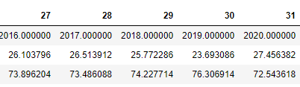
Demographic View: Gender
Overall Fatality Trending – By Gender Overtime:
Suggests while Males represent a greater portion of the fatalities by # but fatalities have dropped at a higher rate than Females.
Question: Have Males reduced the incidence of road fatality at a greater rate than women over the past 20 year?
As a percentage of each year’s fatality rate Males consistently represented 71%(+/- 1%)

Slide 23
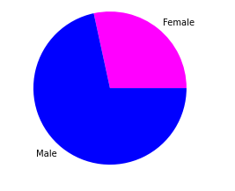
Demographic View: Gender – Total Observations
(Driver, Motorcyclist, Bicyclist only)
Overall Fatality Trending – By Gender Overtime:
Suggests while Males represent a greater portion of the fatalities by # but fatalities have dropped at a higher rate than Females.
Question: Have Males reduced the incidence of road fatality at a greater rate than women over the past 20 year?

Slide 24
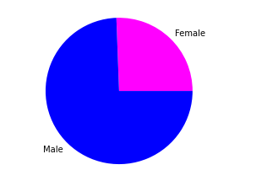
Demographic View: Gender – Single
(Driver, Motorcyclist, Bicyclist only)
Overall Fatality Trending – By Gender Overtime:
Suggests while Males represent a greater portion of the fatalities by # but fatalities have dropped at a higher rate than Females.
Question: Have Males reduced the incidence of road fatality at a greater rate than women over the past 20 year?

Slide 25
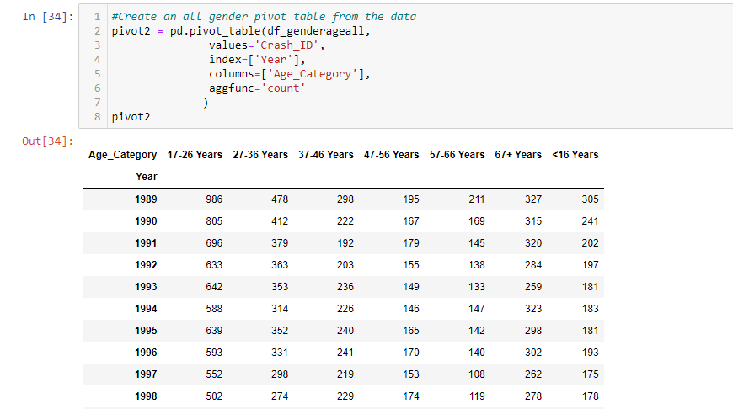
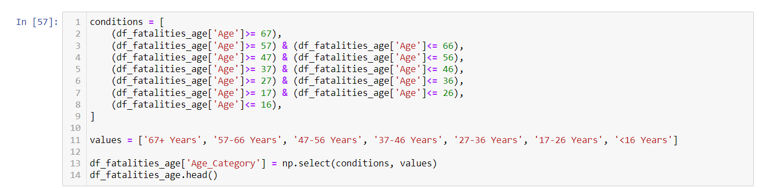
Demographic View: Age Distribution – Overall – Age Grouping
1
Create Column Header
2
Set Conditional Formatting
4
Set Values

Slide 26
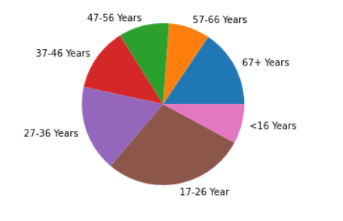
Demographic View: Age Distribution - Overall
Overall Fatality Trending – By Age Overtime:
When considering the entire population of fatalities over the period the vast majority of fatalities are represented by people aged 17-26 years of age followed by those 27-36 Years of age
Is this representation true today when compared to 1989 at the beginning of these observations?
Have the reductions over time been consistent across Age Categories.

Slide 27
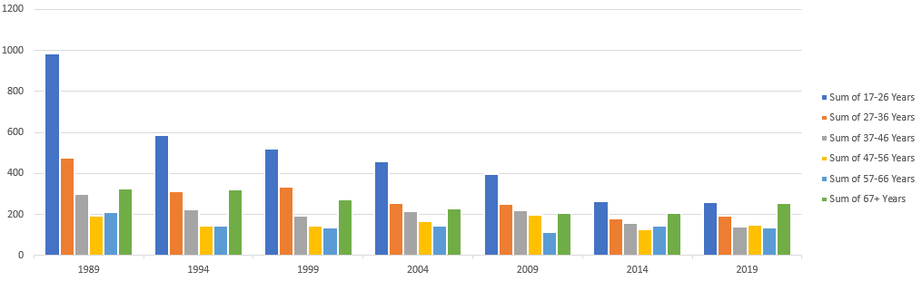
Demographic View: Fatality reduction over time
By Age Category
Overall Fatality Trending – By Age Overtime:
When viewed at 5 yearly increments between 1989 and 2019 it’s apparent that all Age_Categories have seen reductions however the 17-26 Age Category has (by volume) seen the greatest reduction
Those in the 17-26 Age Category are now almost comparable to those >67 Years

Slide 28
Implication: Gender & Age
The safety interventions undertaken have delivered consistent reductions in fatalities across both gender groups.
The interventions have had particular effect in reducing the fatalities amongst the youngest driving cohort (17–26-Year-Olds).
Single Vehicle fatalities are represented by a higher proportion of Males drivers that Female.
Further - Investigation into the Male Single Vehicle fatalities may yield areas of opportunity to positively impact motor vehicle fatalities further.

